Slide 1

Pangenome graph build and variant calling using simulated Neisseria meningitidis genomes:
Issues with the inverted regions
Zuyu(Zoe) Yang
2nd June, 2022

Slide 2
Background of Neisseria meningitidis, NZmenB
Example from 3STs of NZmenB
Notes:
NMI97349=NMI97348,
NMI97348 was removed due to duplication

Slide 3
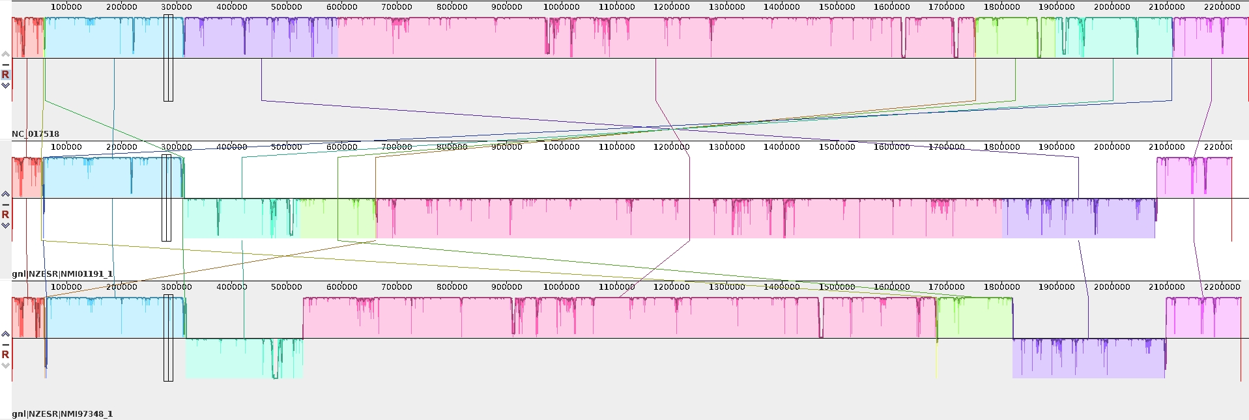
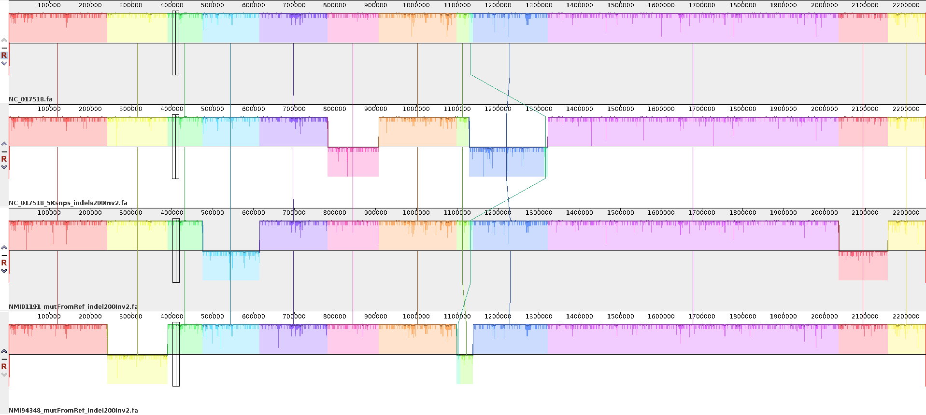
Simulate Neisseria meningitidis genomes
As there are big inversions among the 3ST genomes, to better understand how the pggb graph build and vg variant calling pipeline work, I simulated three genomes from ST42 reference (the best linear reference ), NC_017518 by simuG
ST42: NC_017518, mutate genome bases on know SNPs from ST41, ST154
ST42, NMI01191, 2892SNPs
ST154, NMI97348, 4183SNPs
NC_017518, 5K random SNPs
ST42
ST41
NMI01191mutFromRef
NMI97349mutFromRef
NC_017518_5ksnps
ST154
3ST genome alignment showing big rearrangements
200indels, and 2 inversions
NC_017518
NC_017518_5KsnpsIndel200Inv2
ST41, NMI01191mutRefIndel200Inv2
ST154, NMI97348mutRefIndel200Inv2
Three simulated genomes + original ref as 4Sim genomes
4Sim genome alignment showing big rearrangements

Slide 4
Construct pangenome graph by pggb
4Sims
mash triangle to calculate the distance of genomes, all <0.02
E.g., pggb -i $input -N -s 20000 -p 95 -n 4 -t 16 -S -m -o $output
-s 10k, 20K, 50k, 100K
-p 90, 95
8 run based on different settings of -s and -p
4Sims, 50K, 0.95
10K0.90
Different setting generated high similar pangenome graph for the 4Sim genomes

Slide 5
4Sims
10K0.90
20K0.90
50K0.90
100K0.90
10K0.95
20K0.95
50K0.95
100K0.95

Slide 6
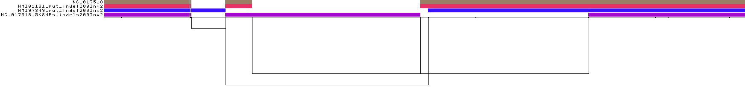
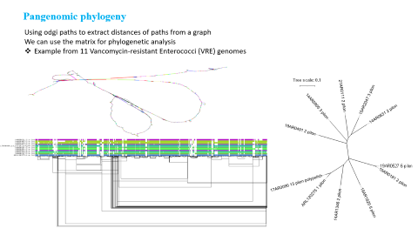
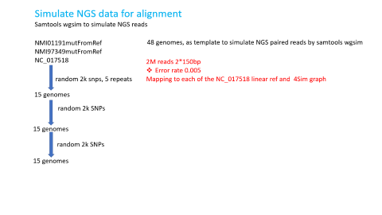
Vg deconstruct graph (50K0.95) into .vcf file
Vg deconstruct –p (all paths) –e, find 5 big inversions from the graph
But there were six inversions from ground truth, what happened in the graph?
NMI97349_mut_indel200 | 240749 | T | <INV> | variant_type=INV;variant_id=INV_2;SVTYPE=INV;EVENT=INV_2;END=389488
NMI01191_mut_indel200 | 474891 | G | <INV> | variant_type=INV;variant_id=INV_2;SVTYPE=INV;EVENT=INV_2;END=614379
NC_017518_5KSNPs_indels200 | 780836 | G | <INV> | variant_type=INV;variant_id=INV_2;SVTYPE=INV;EVENT=INV_2;END=906969
NMI97349_mut_indel200 | 1097087 | A | <INV> | variant_type=INV;variant_id=INV_1;SVTYPE=INV;EVENT=INV_1;END=1137395
NC_017518_5KSNPs_indels200 | 1128122 | G | <INV> | Variant_type=INV;variant_id=INV_1;SVTYPE=INV;EVENT=INV_1;END=1321305
NMI01191_mut_indel200 | 203444 | 4A | <INV> | variant_type=INV;variant_id=INV_1;SVTYPE=INV;EVENT=INV_1;END=2155381
Two inversions are closely located on the pangenome graph, which were recoded as one variant

Slide 7
Simulate NGS data for alignment
Samtools wgsim to simulate NGS reads
NMI01191mutFromRef
NMI97349mutFromRef
NC_017518
48 genomes, as template to simulate NGS paired reads by samtools wgsim
2M reads 2*150bp
Error rate 0.005
Mapping to each of the NC_017518 linear ref and 4Sim graph(50k0.95)
random 2k snps, 5 repeats
15 genomes
random 2k SNPs
As all the graphs are very similar to each other,
I chose 50k0.95 for testing mapping and variant calling cause it has the shortest length of total graph
15 genomes
random 2k SNPs
15 genomes

Slide 8
Variant calling
Vg deconstruct graph
From the vcf file, the graph capture the inversions, but the SNPs in the inversions were not included.
Call variant based on snarls in the graph, without novel variants
Even with seriou of SNPs) Each of the three group datashowed very consistent results,
NMI01191mutFromRef
NMI97349mutFromRef
NC_017518
In order to also consider novel variants from the reads, augment the graph with all variation from the GAM
Call variant can be against to all paths or specific ones
Issues for some ground truth SNPs being missed from the call,
some of them being filtered away by filtering the secondary, ambiguous, and low quality mapping.
Most of them are located at the inverted regions.

Slide 9
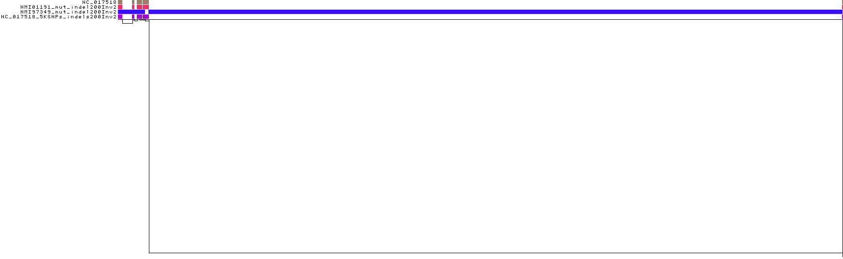
Ground truth SNPs against linear refs and graph
samples . | NMI01191_mutfromRef | NMI97349_mutfromRef
groundTruth_from_NC017518_snps | 2892 | 4183
call_from_single ref_NC017518 | 2892 | 4182(TP)+1(FN)+1(FP)
call_from_4SimGraph(filter secondary and ambiguous read, low mapping quality <5 read), default all paths | 2523(TP)+369(TN) | 3581(TP)+602(TN)
call_from_4SimGraph(no filt secondary and ambiguous read, but remove lq <5 read), default all paths | 2613(TP)+279(TN) | 3598(TP)+585(TN)
call_from_4SimGraph(no filt secondary and ambiguous read, all reads included ), default all paths | 2823(TP)+69(TN) | 3869(TP)+314(TN)
call_from_4SimGraph(no filt secondary and ambiguous read, all reads included )_single path, NC_17518 | 2823(TP)+69(TN) | 3869(TP)+314(TN)
Some regions from the graph are missing, mainly the inverted regions which can be flited out by filtering secondary, ambiguous mapping reads and low mapping quality
When include all the reads for variant calling, most of the TN SNPs located at the inverted region can be rescued.
But there is still 69 TN for NMI01191_mutfromRef,what happened to them in the graph?

Slide 10
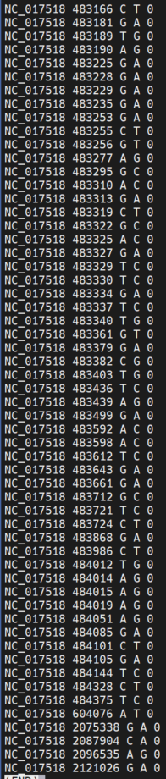
What happened to the TN SNPs in the graph?
Most of the 69 TN for NMI01191_mutfromRef are located at a certain inverted region
And the SNPs are within inverted regions in one of the path, NMI01191_mutfromRef_200Indels2Inv2,
Which has two inversions, 474891 to 614379, and 2034444 to 2155231

Slide 11
Call variants from each path of the graph
Call, merge, remove duplication according to ID, remove potential error
With filtering the reads also caused about 1/3 variants being filtered away. The following examples are from NC_017518 groups (NC_017518 and its series further mutated genomes) without filtering
1, call variant using all reads, and set variants no less than 3 supported reads and more than 10 total reads
2, check the PASS sites and found the genotypes are 1/1, 0/1, 1/0…….
3, As my data is bacterial, it’s weird to see the != 1/1 genotype.
So further check PASS but genotype are not 1/1,
 |  | NC_017518 | NC_017518_2k_1 | NC_017518_2k_1_2k | NC_017518_2k_1_2k_2k | NC_017518_2k_2 | NC_017518_2k_2_2k | NC_017518_2k_2_2k_2k | NC_017518_2k_3 | NC_017518_2k_3_2k | NC_017518_2k_3_2k_2k | NC_017518_2k_4 | NC_017518_2k_4_2k | NC_017518_2k_4_2k_2k | NC_017518_2k_5 | NC_017518_2k_5_2k | NC_017518_2k_5_2k_2k
Using the graph based on -s 50K, -p 95 | all | 10473 | 13147 | 15924 | 18565 | 13223 | 15890 | 18628 | 13141 | 15818 | 18545 | 13201 | 16033 | 18766 | 13204 | 16071 | 18732
 | no pass | 1370 | 1363 | 1498 | 1478 | 1440 | 1446 | 1532 | 1348 | 1365 | 1406 | 1362 | 1479 | 1505 | 1390 | 1502 | 1442
 | pass | 9103 | 11784 | 14426 | 17087 | 11783 | 14444 | 17096 | 11793 | 14453 | 17139 | 11839 | 14554 | 17261 | 11814 | 14569 | 17290
 | pass, ==GT1/1 | 8869 | 11313 | 13705 | 16093 | 11278 | 13665 | 16028 | 11292 | 13663 | 16085 | 11338 | 13754 | 16221 | 11272 | 13701 | 16118
 | pass, !=GT1/1 | 234 | 471 | 721 | 994 | 505 | 779 | 1068 | 501 | 790 | 1054 | 501 | 800 | 1040 | 542 | 868 | 1172
 |  | NC_017518 | NC_017518_2k_1 | NC_017518_2k_1_2k | NC_017518_2k_1_2k_2k | NC_017518_2k_2 | NC_017518_2k_2_2k | NC_017518_2k_2_2k_2k | NC_017518_2k_3 | NC_017518_2k_3_2k | NC_017518_2k_3_2k_2k | NC_017518_2k_4 | NC_017518_2k_4_2k | NC_017518_2k_4_2k_2k | NC_017518_2k_5 | NC_017518_2k_5_2k | NC_017518_2k_5_2k_2k
Using the graph based on -s 50K, -p 90 | all | 10305 | 12947 | 15723 | 18392 | 13033 | 15699 | 18438 | 12975 | 15614 | 18384 | 13024 | 15830 | 18571 | 12998 | 15861 | 18515
 | no pass | 1390 | 1363 | 1492 | 1495 | 1440 | 1454 | 1524 | 1364 | 1357 | 1430 | 1371 | 1465 | 1504 | 1375 | 1492 | 1421
 | pass | 8915 | 11584 | 14231 | 16897 | 11593 | 14245 | 16914 | 11611 | 14257 | 16954 | 11653 | 14365 | 17067 | 11623 | 14369 | 17094
 | pass, ==GT1/1 | 8870 | 11311 | 13701 | 16097 | 11279 | 13660 | 16030 | 11284 | 13664 | 16087 | 11333 | 13750 | 16194 | 11266 | 13697 | 16112
 | pass, !=GT1/1 | 45 | 273 | 530 | 800 | 314 | 585 | 884 | 327 | 593 | 867 | 320 | 615 | 873 | 357 | 672 | 982

Slide 12
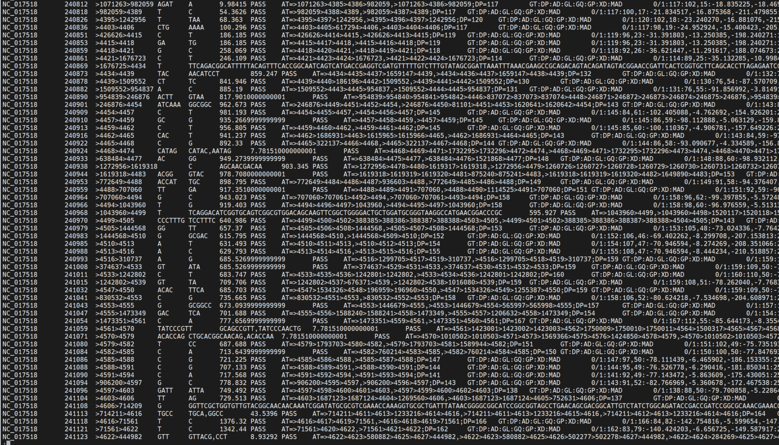
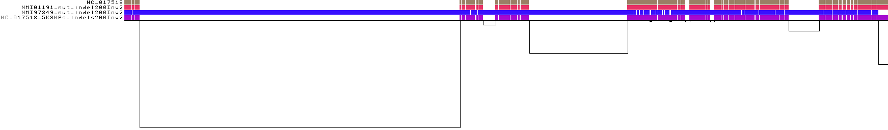
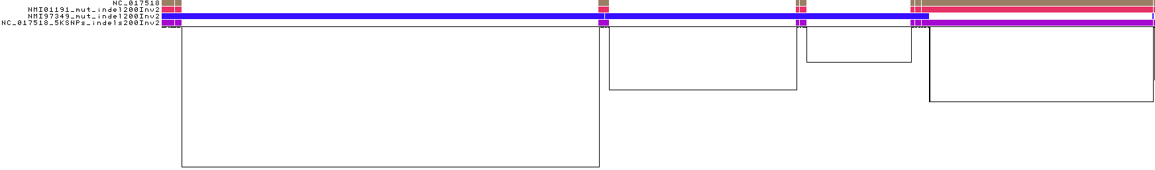
Check the GT!=1/1 sites
From NC_017518, from the graph 50k0.95, I further checked the 234 PASS variants but genotype are not 1/1 for
227 of them are at within a certain region, which is poorly aligned, See NC_017518:240800-242100
4SimGraph, 50K0.95, NC_017518:240800-242100
From NC_017518, from the graph 50k0.90, 45 PASS variants but genotype are not 1/1 for NC_017518.
The alignment is improved, but still a small region
4SimGraph, 50K0.90, NC_017518:240800-242100

Slide 13
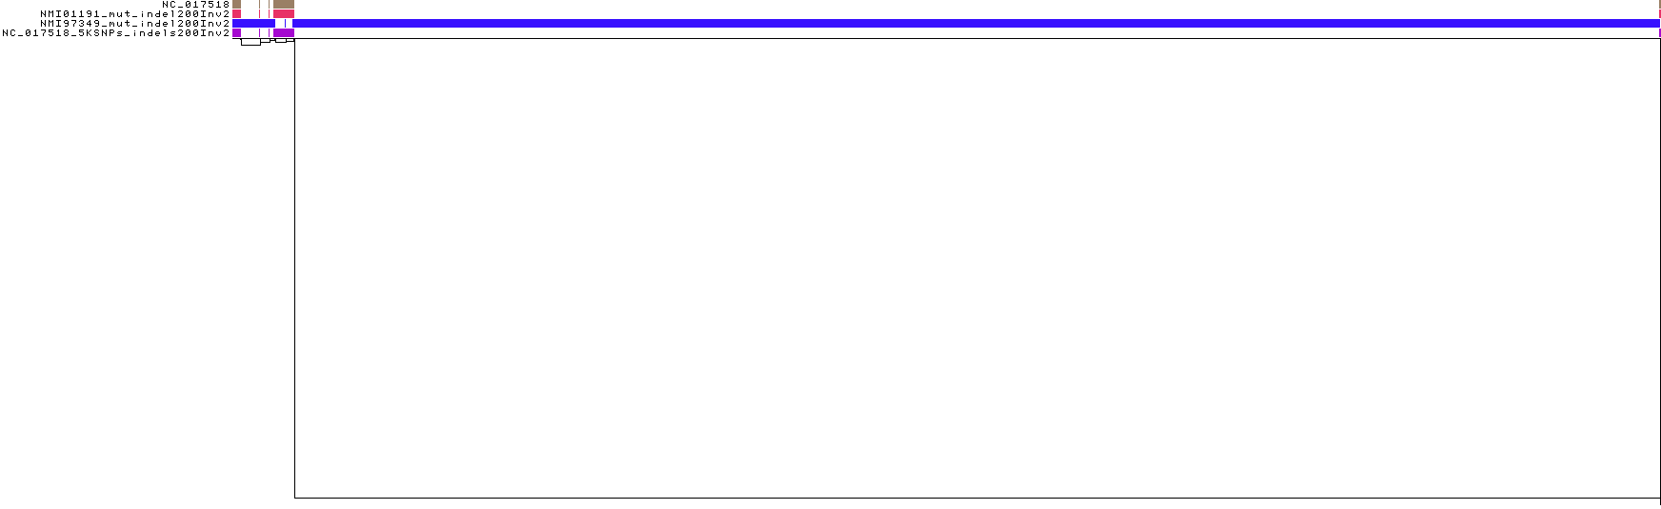
Check the GT!=1/1 sites, poorly aligned region
4SimGraph, 50K0.95, NC_017518:240000-243000
4SimGraph, 50K0.90, NC_017518:240000-243000

Slide 14
Summary
The graph building by pggb works ok. Different settings generate high similar graph. And the graphs captured all the inverted events, but two of them are very close, being recorded as one event.
The snarls from the graph didn’t include the SNPs in the inverted regions, which should be consider as variants too.
When map NGS short reads to the graph, the reads mapped to the invented regions recorded as secondary mapping, ambiguous mapping or with low mapping quality, which will be filtered out with filtering.
A tiny region at the beginning of one inversion are poorly aligned that caused some confusing of variant calling at this regions. 50k0.90 graph works better than 50k0.95 graph(See slide 12). I guess this can be further improved.

